Slide 1

Course Name - Object Oriented Programming using Java
Lecture 35 – Applet Programming: Basics, applet life cycle, difference between application & applet programming
Presented By
Dr. Sudipta Sahana
Asso. Prof.
Dept. of CSE
UEM – Kolkata

Slide 2
Topic of Interest
Basics of Applet Programming
Applet Life Cycle
Difference Between Application & Applet Programming
Example of Applet creation

Slide 3
Basics of Applet Programming
Applet is a special type of program that is embedded in the webpage to generate
the dynamic content. It runs inside the browser and works at client side.
Advantages of Applet:
There are many advantages of applet. They are as follows:
It works at client side so less response time.
Secured
It can be executed by browsers running under many platforms, including Linux, Windows, Mac OS etc.
Drawback of Applet:
Plugin is required at client browser to execute applet.

Slide 4
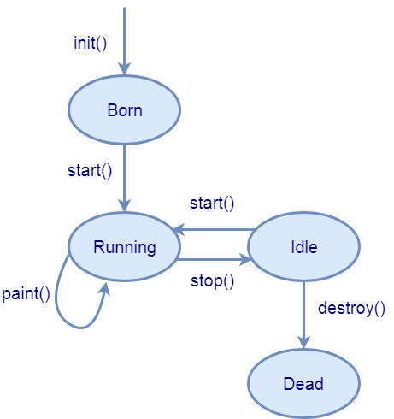
Applet Life Cycle
The methods in the Applet class gives you the framework on which you build any serious applet

Slide 5
Applet Life Cycle Continued…
Four methods in the Applet class gives you the framework on which you build any serious applet
init- This method is intended for whatever initialization is needed for your applet. It is called after the param tags inside the applet tag have been processed.
start- This method is automatically called after the browser calls the init method. It is also called whenever the user returns to the page containing the applet after having gone off to other pages.

Slide 6
Applet Life Cycle Continued…
stop - This method is automatically called when the user moves off the page on which the applet sits. It can, therefore, be called repeatedly in the same applet.
destroy- This method is only called when the browser shuts down normally. Because applets are meant to live on an HTML page, you should not normally leave resources behind after a user leaves the page that contains the applet.
paint − Invoked immediately after the start() method, and also any time the applet needs to repaint itself in the browser. The paint() method is actually inherited from the java.awt.

Slide 7
Difference Between Application & Applet Programming
There are some important differences between an applet and a standalone Java application, including the following –
An applet is a Java class that extends the java.applet.Applet class.
A main() method is not invoked on an applet, and an applet class will not define main().
Applets are designed to be embedded within an HTML page.

Slide 8
Difference Between Application & Applet Programming
When a user views an HTML page that contains an applet, the code for the applet is downloaded to the user's machine.
A JVM is required to view an applet. The JVM can be either a plug-in of the Web browser or a separate runtime environment.
The JVM on the user's machine creates an instance of the applet class and invokes various methods during the applet's lifetime.
Applets have strict security rules that are enforced by the Web browser. The security of an applet is often referred to as sandbox security, comparing the applet to a child playing in a sandbox with various rules that must be followed.

Slide 9
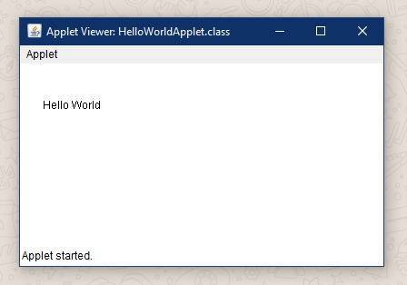
Example of Applet Creation
The following is a simple applet named HelloWorldApplet.java:
HelloWorldApplet.java
import java.applet.*;
import java.awt.*;
public class HelloWorldApplet extends Applet
{
public void paint (Graphics g)
{
g.drawString ("Hello World", 25, 50);
}
}
ab.html
<applet code=" HelloWorldApplet "
width="400" height="200">
</applet>
Command to run an Applet Program
javac HelloWorldApplet.java
appletviewer ab.html

Slide 10
Thank You

